Slide 1
Levels of Organisation

Slide 2
In this Smart lesson, you will be doing the following:
1. | Recalling the levels of organisation in the body.
2. | Describing how the levels of organisation work together to form an organism.
3. | Classifying components of living things as cells, tissue, organs or organ systems.

Slide 3
The levels of organisation are:
The smallest level of organisation is the cell. Many cells combine to form a tissue. The cells within a tissue are always of the same type. For instance, muscle cells group together to form muscle tissue.
Humans have four types of tissue: muscle, nervous, connective and epithelial tissue.

Slide 4
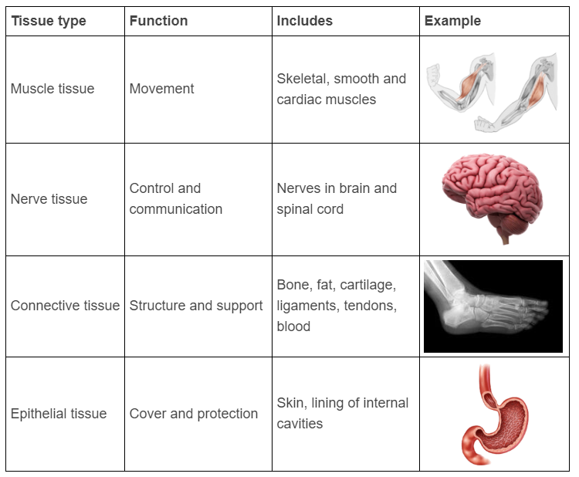
Here is a summary of the four main types of tissue found in humans:

Slide 5
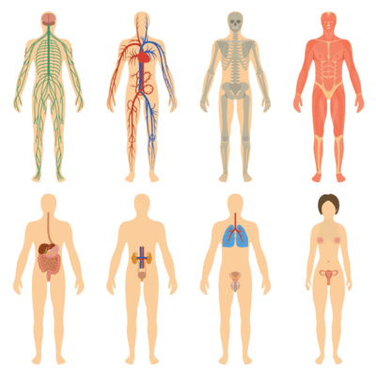
Levels of organisation allow for complex processes to be controlled and coordinated in every cell of an organism.
There are many levels of organisation in your body, and they are all important for your body to function properly. Your body is organised so that different parts do different functions, such as movement, digestion, and excreting waste.

Slide 6
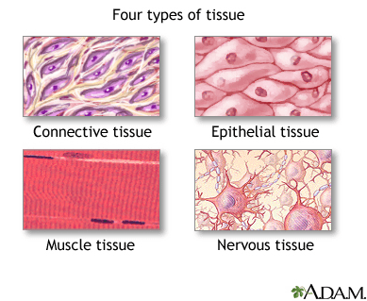
You have just learnt that similar cells are grouped together to form tissues.

Slide 7
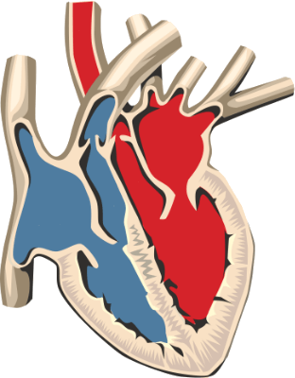
Several different types of tissues are grouped together in a specific way that allows them to perform a certain function.
A structure that contains more than one type of tissue working together is called an organ.
For example, the heart is an organ that contains cardiac muscle tissue to contract and relax, as well as nerve tissue to control the rate of contraction, and connective tissue to make up the valves for blood to flow through.

Slide 8
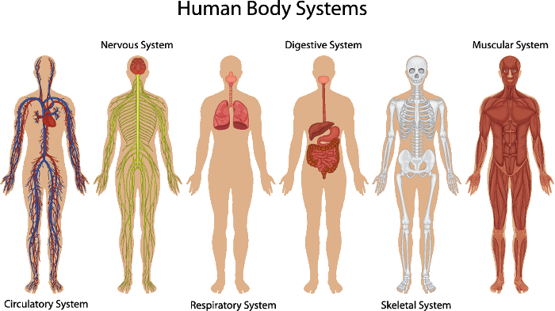
An organ system is an even higher level of organisation.
Organ systems consist of functionally related organs. These different organs are grouped together to perform a specific function.
For example, your stomach is grouped together with your mouth, oesophagus, small intestines and large intestines to digest food and release nutrients. Together these organs make up the digestive system.

Slide 9

And finally, your organ systems are grouped together to make up you - an organism!

Slide 10
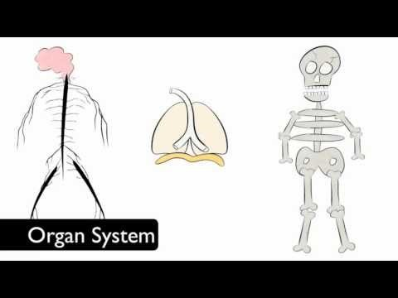

Slide 11
Here's a summary of the levels of organisation in multicellular organisms (like you):
• | All multicellular organisms are made up of cells.
• | Similar cells group together to form tissues.
• | Tissues group together to form organs.
• | Organs group together to form organ systems.
• | All the organ systems together form the organism.

